Slide 1

Project Progress Seminar III on “ Development of an Application for Pets ”
Presented By
Mr. Yash Kashti
Mr. Aman Ilatkar
Mr. Sahil Mahato
Mr. Yash Chikte
Mr. Vedant Chimote
Guided By
Mr. Swapnil Mahajan
Ms. Nikita Jamgade
Department of Computer Science & Engineering
S. B. JAIN INSTITUTE OF TECHNOLOGY MANAGEMENT AND RESEARCH, NAGPUR
An Autonomous Institute, Affiliated to RTMNU, Nagpur

Slide 2
Contents
Problem Statement & Objectives
Introduction
Literature Survey
System Design
Proposed Work
Developed Modules
Screenshots
Technology Used
Advantages & Applications
References
Conclusion
S. B. Jain Institute of Technology Management and Research
2

Slide 3
Problem Statement & Objectives
Problem Statement :
Today's trend consists of professionals having their families later in life or deciding not to have children at all. Pet owners are increasingly treating their pets as they would their children. Pets aren't just part of the family anymore. In some cases, they are family. They are willing to invest lots of money to have them cared for in an environment that would mirror their home surroundings.
Objectives:
To provide pet grooming services.
To provide veterinary services.
To provide door-to-door service.
To provide hassle-free reservations for the pet.
To provide a user-friendly and informative mobile application.
3
S. B. Jain Institute of Technology Management and Research

Slide 4
Introduction
India is one of the fastest growing pet care markets in the world
Around 30,000 people adopted pets in the pandemic
According to the Times of India pet styling industry has grown in few years. A large amount of revenue is generated through this business.
Pet owners are increasingly treating their pets as their own child willing to invest lots of money on them so that they are best in their health and looks.
Our target customers are pet owners not restricted to only one pet per household and those who are willing to take services for their pets.
S. B. Jain Institute of Technology Management and Research
4

Slide 5
Literature Survey
Websites / Paper / Article | Reviews / Findings
American Veterinary Medical Association . U.S. Pet Ownership & Demographics Sourcebook. American Veterinary Medical Association; Schaumberg, IL, USA: 2012. | It discusses about maintaining the well-being of the pets , proper medications and quality grooming can be achieved .
American Pets Owner Association. 2021-2022 APPA National Pet Owners Survey. Greenwhich, CT: American Pets Owner Association (2021). | This give an important insight about the market of the business. It talks about the potential this industry has.
Pet Industry Trends, Growth & Statistics in 2022 and Beyond: Unleashing Your Ecommerce Pet Marketing Strategies by Reilly Roberts, Jun. 11 2022 | It focuses on the competition that brick-and-mortar pet stores face in today’s crowded pet supplies market, these retailers are increasingly looking for new ways to draw customer traffic into their aisles.
S. B. Jain Institute of Technology Management and research
5

Slide 6
Real Time Survey
Scoopy Scrub, Nagpur:
Scoopy Scrub located in Laxmi Nagar, Nagpur which provides pet grooming with a large variety of services. They provide services such as training, dog walkers, cat and dog grooming and styling, pet boarding, hair grooming, pet transportation, etc.
Dogz Planet, Nagpur:
Dogz planet located in Gokulpeth, Nagpur provides grooming, pet care, food and nutrition.
Animal Health Care Centre, Nagpur:
Animal Health Care Center located at Central Avenue road, Nagpur provides animal treatment, consultation, pet vaccination and all kinds of pet accessories and food.
Little Pet’s Paradise, Nagpur:
Little Pet’s Paradise is located near Central Avenue road, Nagpur provides grooming services for pets such as nail trimming, bathing, hair cutting, making pets groomed for pet shows, etc.
S. B. Jain Institute of Technology Management and research
6

Slide 7
Real Time Survey
Alphawings pet solution’s, Nagpur:
Alphawings pet solution’s located near Manewada road provides services only related to dogs such as dog bathing and blow dry, ear cleaning, flea and tick treatment, nail trimming, grooming and styling.
Catbase grooming center, Nagpur:
Catebase Grooming center is located in Jafar Nagar, Nagpur which only provides cat grooming and boarding services.
Petazoo, Nagpur:
Petazoo which is located in Trimurti Nagar, Nagpur provides various services for cats and dogs. They provide bathing, ear cleaning, nail trimming, flea and tick treatment, tooth brushing, body color and medical therapy.
Vitsprecious pet solutions, Nagpur:
Vitsprecious pet solutions located in Trimurti Nagar, Nagpur provides services such as day care, pet sitting, dog walking, pet food and they even sell various types of pets.
S. B. Jain Institute of Technology Management and research
7

Slide 8
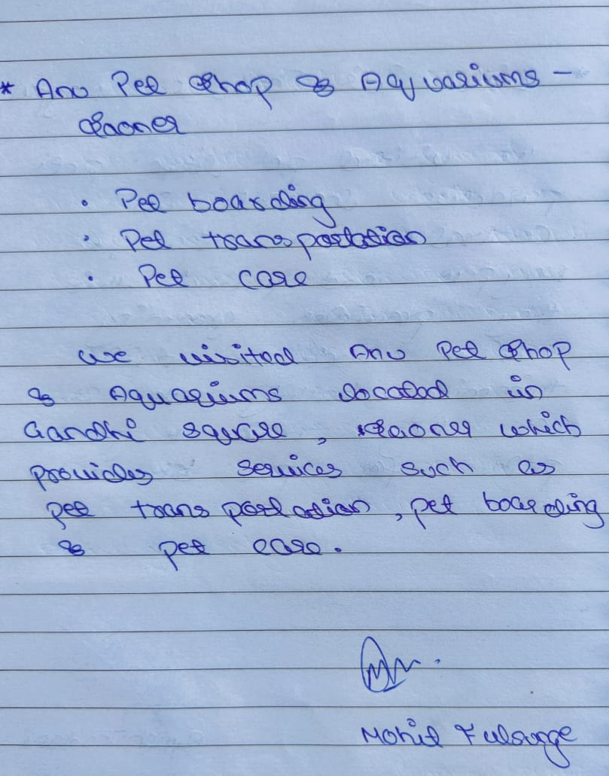
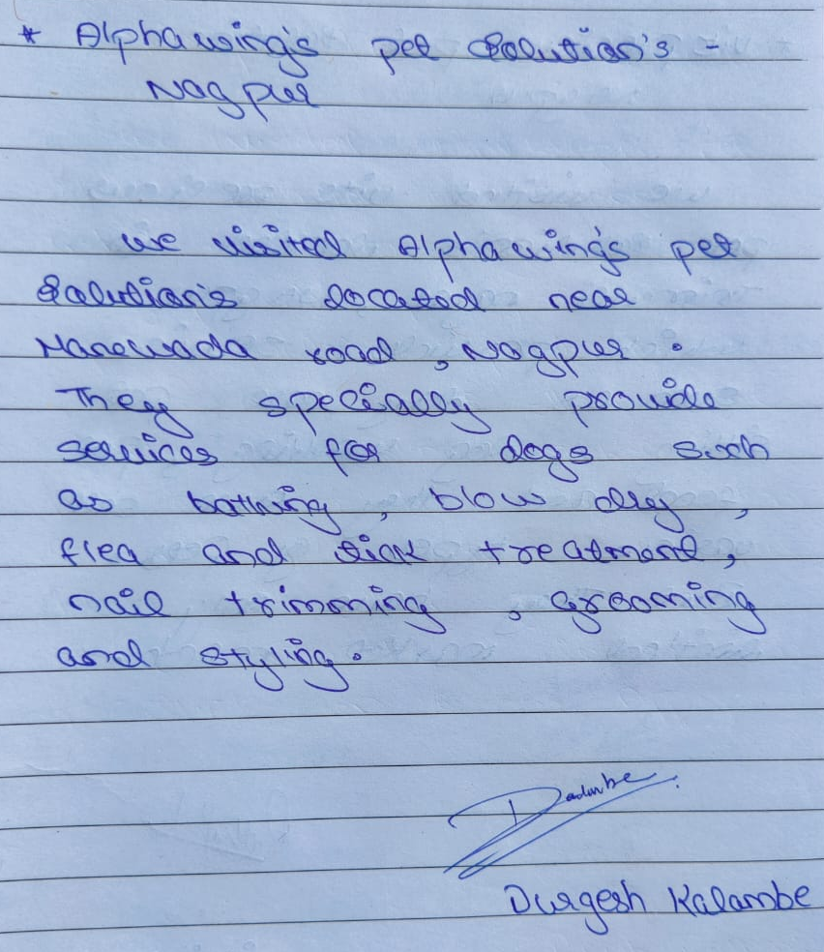
Real Time Survey
S. B. Jain Institute of Technology Management and Research
8

Slide 9
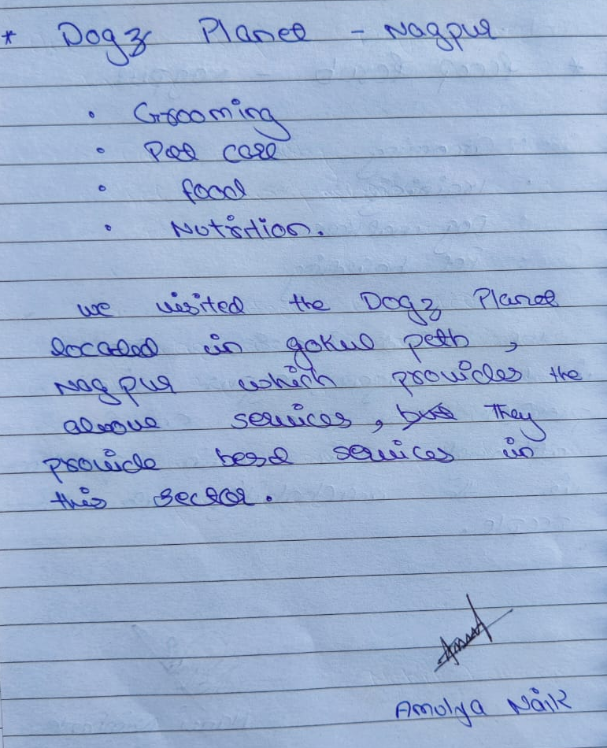
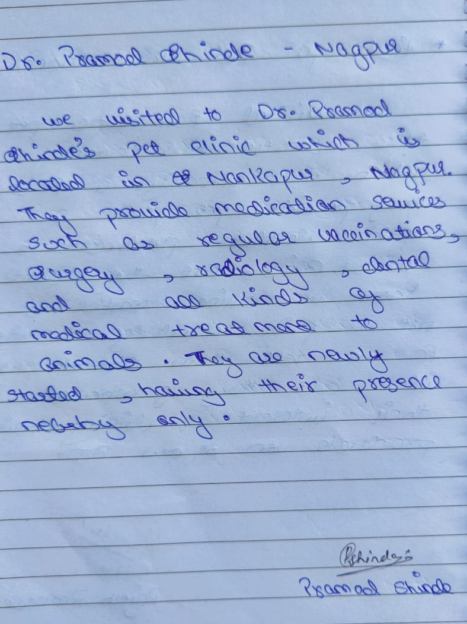
Real Time Survey
S. B. Jain Institute of Technology Management and Research
9

Slide 10
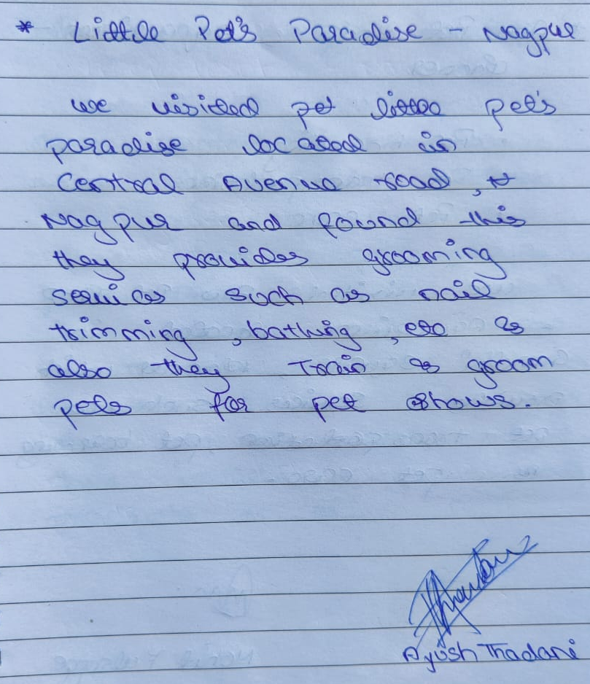
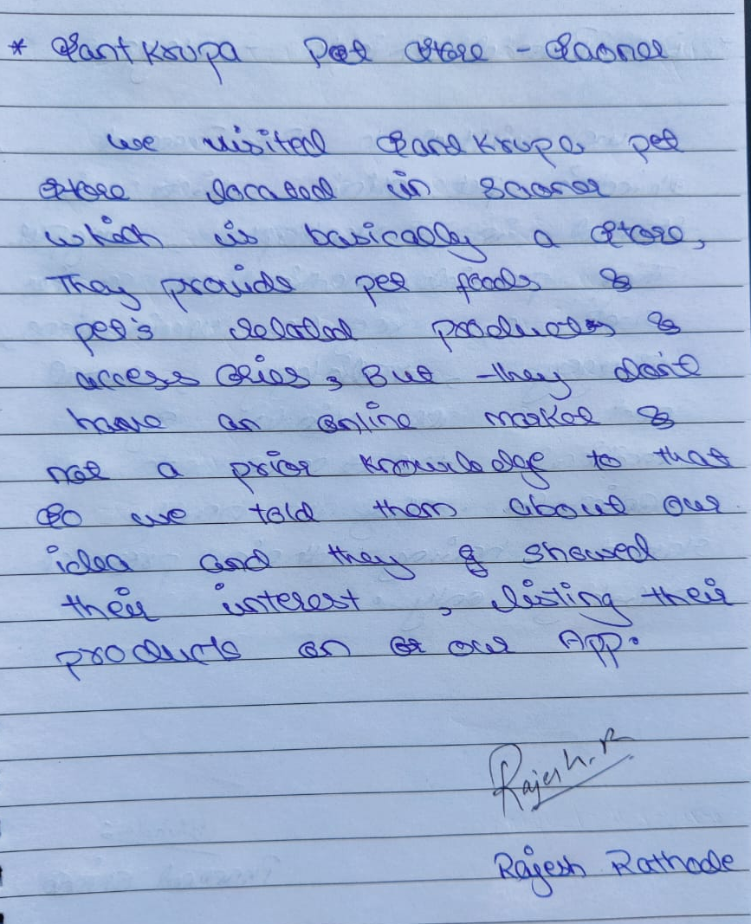
Real Time Survey
S. B. Jain Institute of Technology Management and Research
10

Slide 11
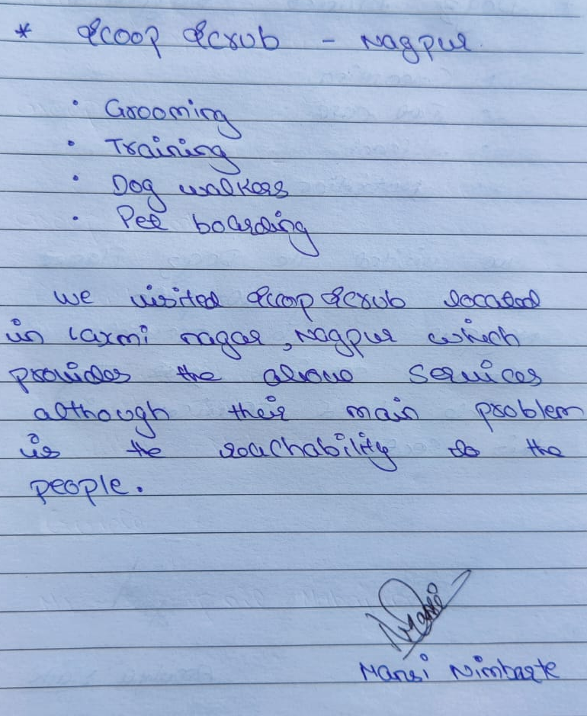
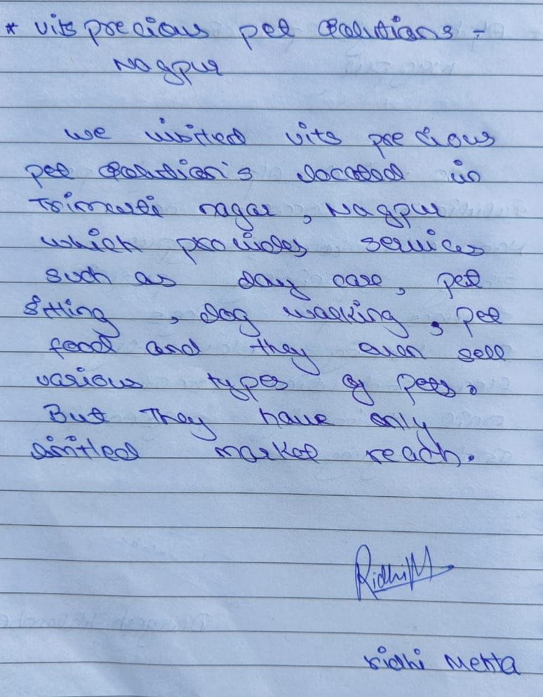
Real Time Survey
S. B. Jain Institute of Technology Management and Research
11

Slide 12
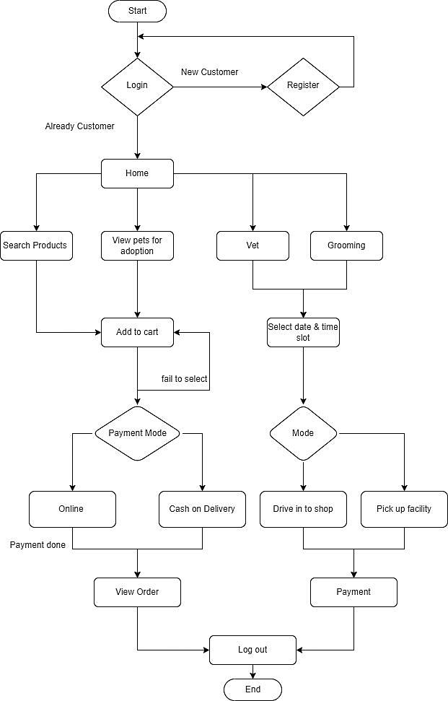
System Design: System Flowchart
S. B. Jain Institute of Technology Management and Research
12

Slide 13
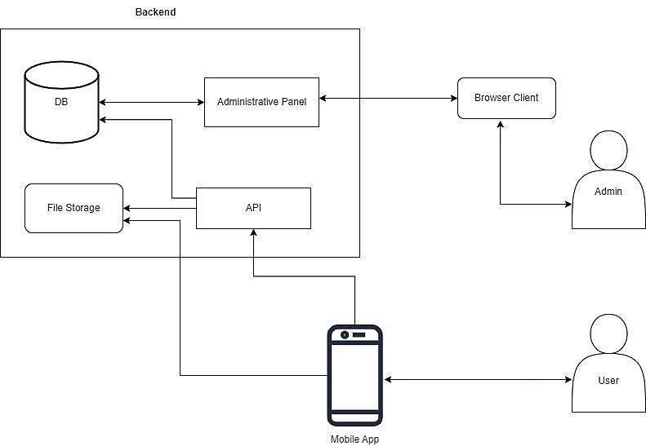
System Design: System Architecture
S. B. Jain Institute of Technology Management and Research
13

Slide 14
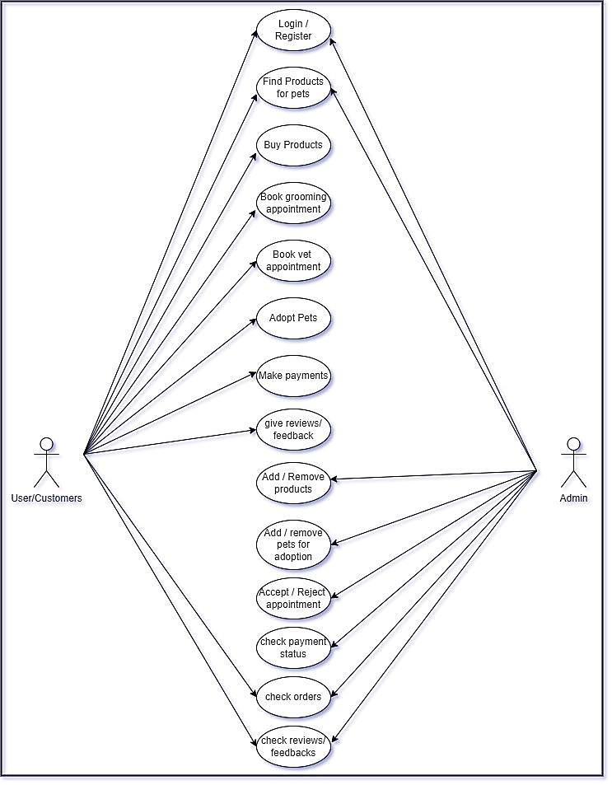
System Design: Use Case Diagram
S. B. Jain Institute of Technology Management and Research
14

Slide 15
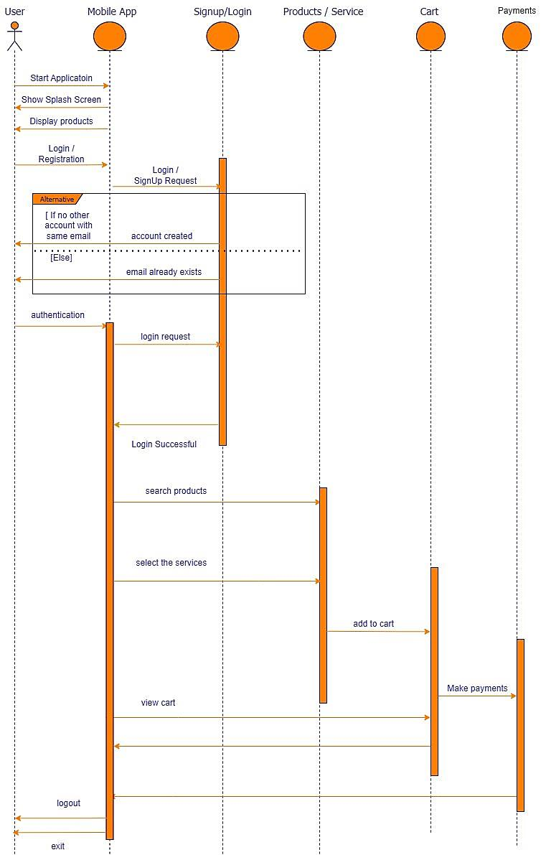
System Design: Sequence Diagram
S. B. Jain Institute of Technology Management and Research
15

Slide 16
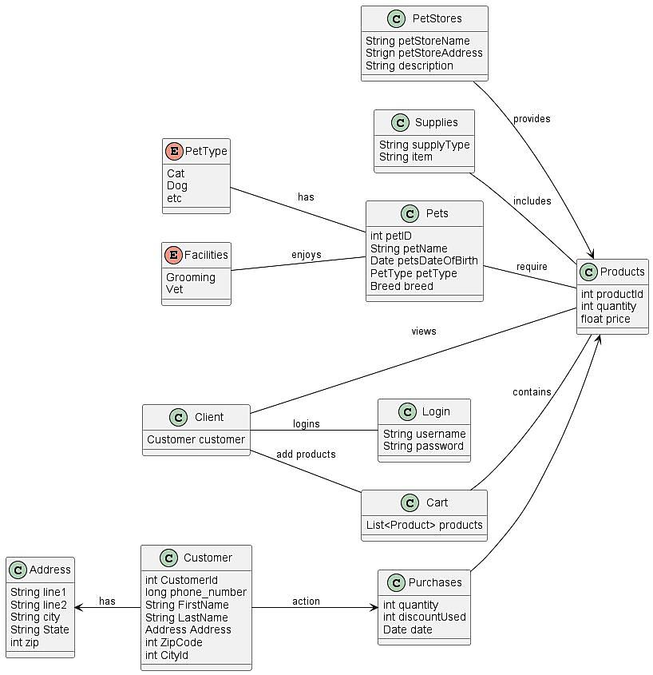
System Design: Class Diagram
S. B. Jain Institute of Technology Management and Research
16

Slide 17
Proposed Work
The intent of our project is that the user should get all types services for their pets which are provided by the various shops. The user should afford and compare prices of services provided by the shops across the city. The client must get all types of veterinary services used for the treatment of many kinds of diseases of their pets. Our marketplace will be simple where all the service providers will provide all kinds of services provided by them so that the customer can book them accordingly. Services such as grooming, training, day care, pet boarding and veterinary will be added by the providers.
Our application is simple where the customer can book appointments with just login and payment. Our app will be user friendly. The principle of our app is to satisfy the customer with all his needs. We aim to get every person and their pet to connect with us.
S. B. Jain Institute of Technology Management and Research
17

Slide 18
Developed Modules
Module 1: Admin
Admin Dashboard: Admin can see all records of the products, services and orders.
Manage Products: Admin can Add/update and delete products as well as pets and services.
Admin Management: Admin can Login/ Log out.
Module 2: User /Customer
Home: User/Customer can search for various kinds of products for their pets and, they can book appointment for vet as well as for grooming services.
User will also be able to see the products under certain subcategory of that pet accessories.
User can give reviews about the product and services.
Order/Appointment Management: Users/customers can view and process orders and pay for same also book an appointment for services.
Customer Managements: User/customer can Login/ log out, View/ Update Profile.
S. B. Jain Institute of Technology Management and Research
18

Slide 19
Technology Used
Code Base : Ionic, Angular, Cordova
Backend : PHP
Database : MySQL
Packages:
One Signal – for push notifications
Stripe – for payments
Cache Network image – to image from internet
Firebase – Analytics
HTTP any – for consuming HTTP resources
S. B. Jain Institute of Technology Management and research
19

Slide 20
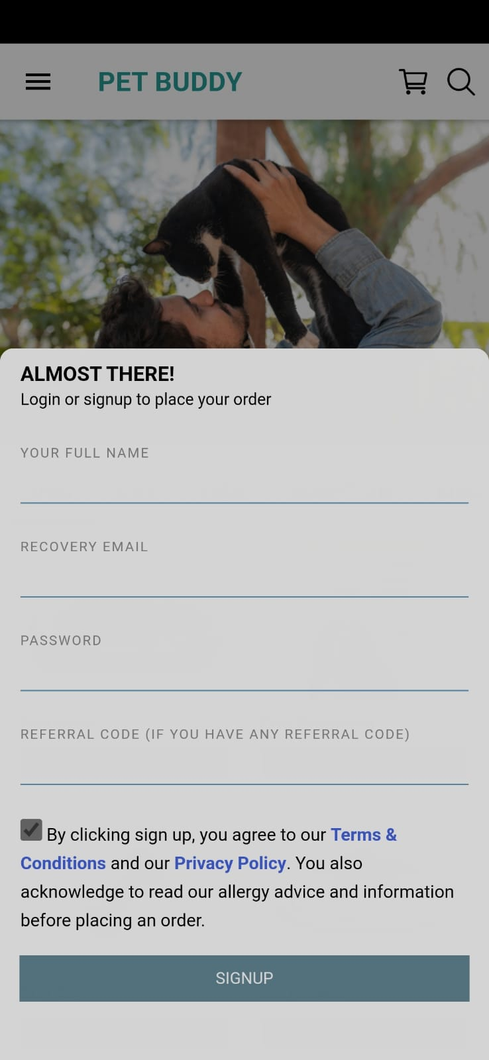
Screen Shots
Login Page
This is the Login Page of our application.
The user needs to verify his phone number then enter his details.
After agreeing to the terms and conditions of our application the user can signup.
The user can login by entering his/her phone number and by entering password.
S. B. Jain Institute of Technology Management and Research
20

Slide 21
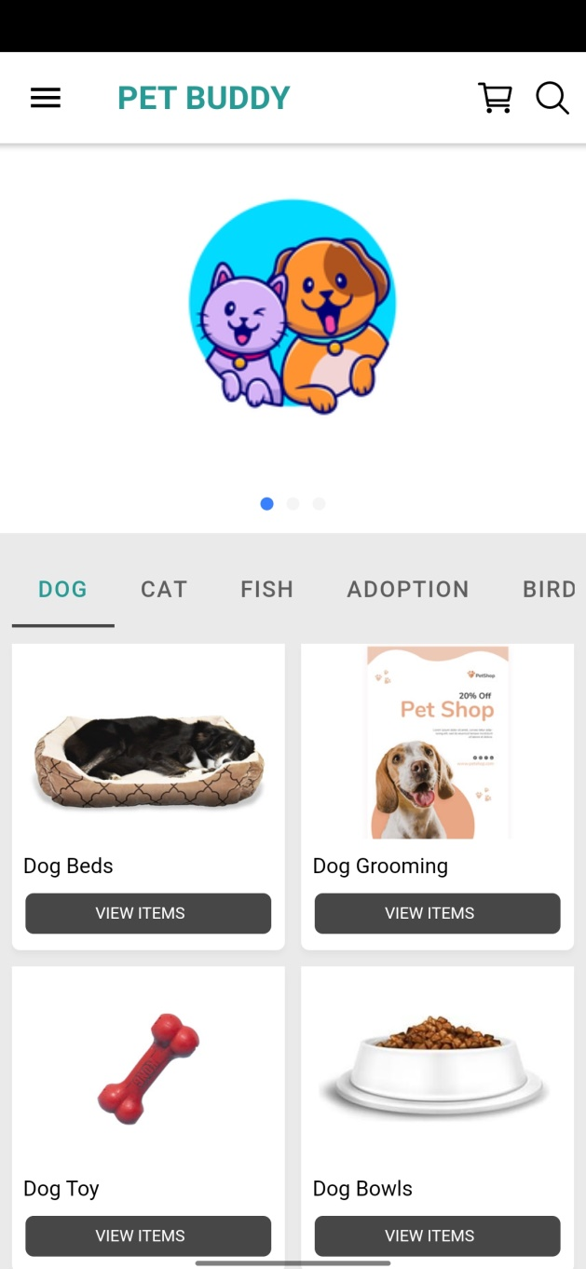
Screen Shots
Home Page
This is the Home Page of our application.
The user can check different categories of pets.
The user can check various products.
The user can then add the items to cart and order those products.
S. B. Jain Institute of Technology Management and Research
21

Slide 22
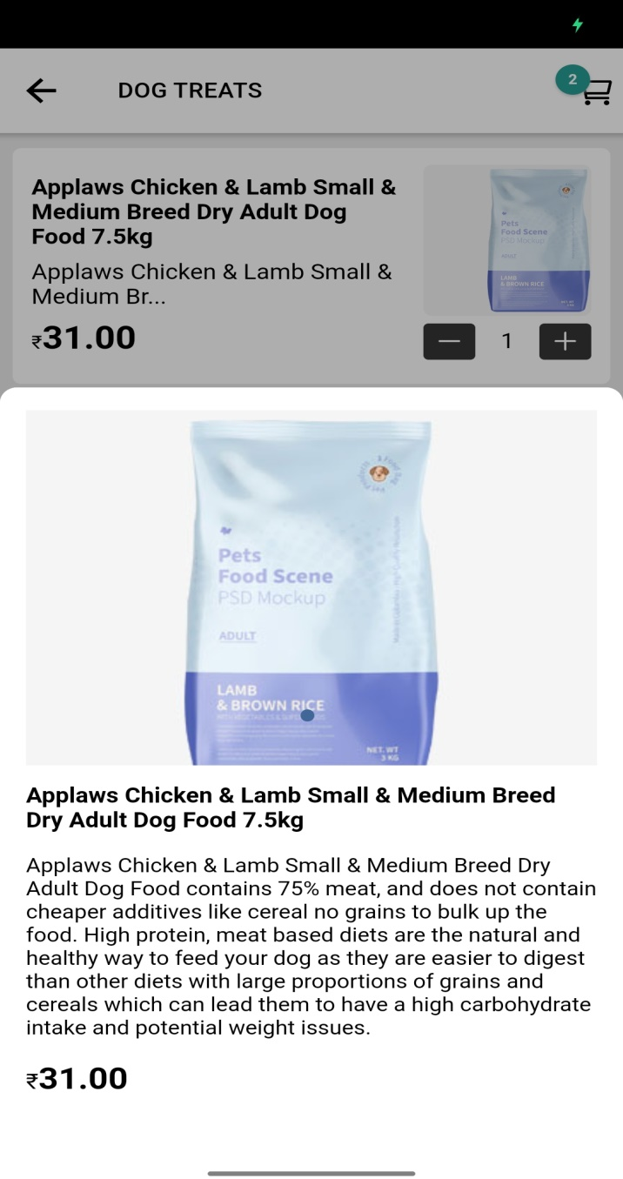
Screen Shots
Product Description Page
This is the Product Description Page of our application.
The user can check different categories of products.
The user can also check the product description.
The user can then add the items to cart and order those products.
S. B. Jain Institute of Technology Management and Research
22

Slide 23

Screen Shots
About Us Page
This is the About Us Page of our application.
The user can check about the application and know more about the company.
The user can check the team of the application and can see their social media pages.
The user can also see the work provided by the providers.
S. B. Jain Institute of Technology Management and Research
23

Slide 24
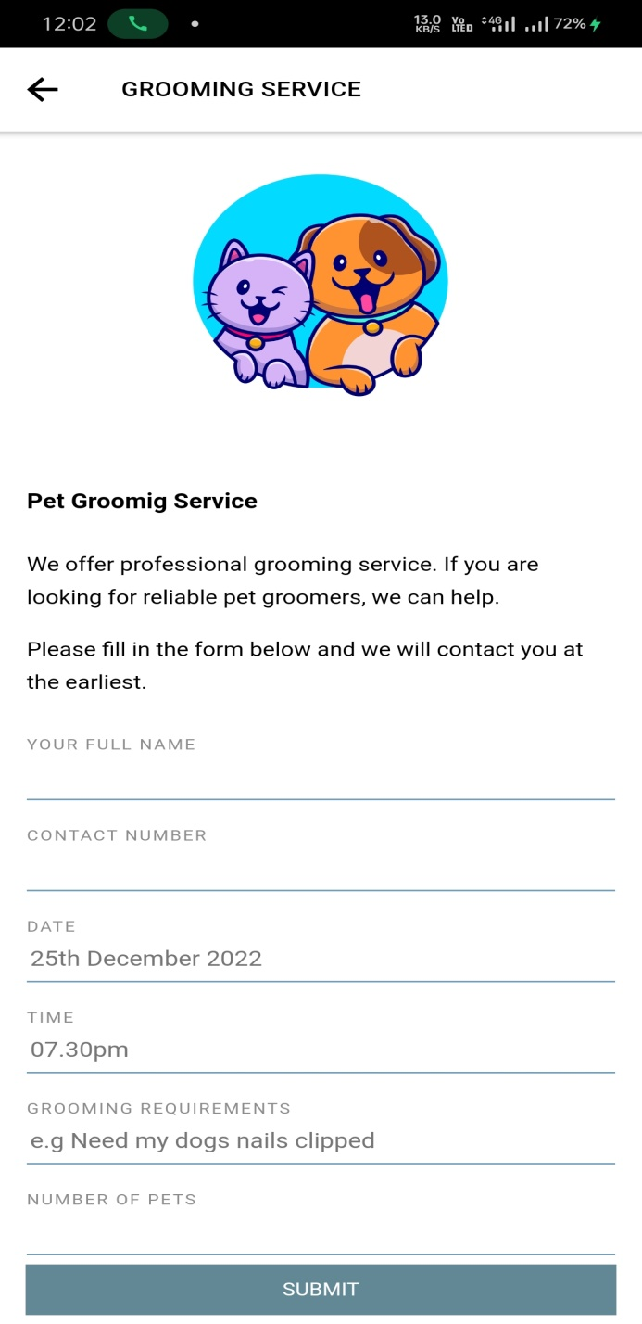
Screen Shots
Grooming Service Page
This is the Grooming Service Page of our application.
The user can book appointment for his pet.
The user has to enter his/her name, contact number, date of grooming, time, his/her requirements and the number of pets he/she has.
The user then can pay for the appointment.
S. B. Jain Institute of Technology Management and Research
24

Slide 25
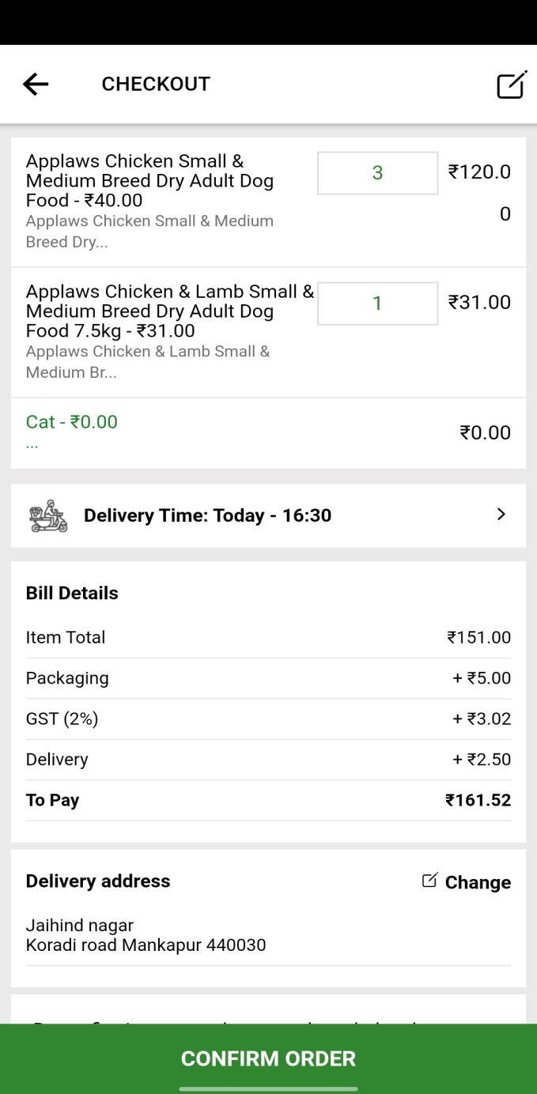
Screen Shots
Checkout Page
This is the Checkout Page of our application.
The user can buy products for their pets.
After selecting the product and quantity the user can add the products to cart and can pay online or can select cash on delivery.
S. B. Jain Institute of Technology Management and Research
25

Slide 26
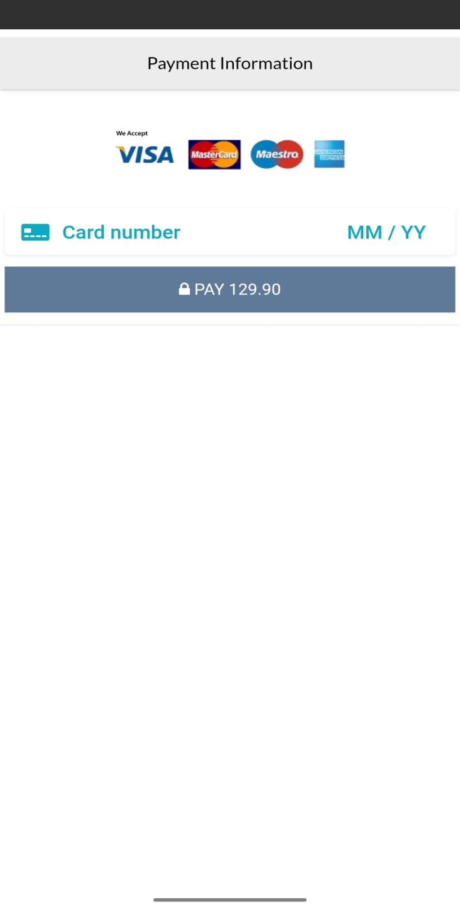
Screen Shots
Payment Page
This is the Payment Page of our application.
The user can buy products for their pets and can also book services for them.
The user needs to enter his card details and pay.
S. B. Jain Institute of Technology Management and Research
26

Slide 27
Advantages & Applications
Advantages:
Pet Grooming can be done by door step services.
We have multiple sellers.
Multiple sellers means more variety of services provided.
Pet sitting and boarding will help the pet parent to leave the city for days
S. B. Jain Institute of Technology Management and Research
27

Slide 28
Advantages & Applications
Applications:
This will be a one stop solution to get all kind of services for pets.
Veterinary services can be used to treat many kind of diseases of the pets.
Pet grooming has a great significance in this modern world.
Service providers/ Doctors can list themselves in our application and provide their services.
Pet day care and boarding will provide the pet parent to go out of town for days.
S. B. Jain Institute of Technology Management and Research
28

Slide 29
Conclusion
In our work, we designed a mobile application and completed its development by applying engineering knowledge, which provides an approach for helping human beings and their pets. We believe that the application we developed would be beneficial and efficient in today's world and would solve problems for pet owners who care for their pets and want the best services and medical assistance for their pets. It analyzes how many pet parents there are in a locality so we can provide our services throughout the city. We have used modern tools like Ionic to implement the project.
S. B. Jain Institute of Technology Management and Research
29

Slide 30
References
Papers:
[1] American Veterinary Medical Association . U.S. Pet Ownership & Demographics Sourcebook. American Veterinary Medical Association; Schaumberg, IL, USA: 2012. [Google Scholar]
[2] American Pets Owner Association. 2021-2022 APPA National Pet Owners Survey. Greenwhich, CT: American Pets Owner Association (2021).
[3] Pet Industry Trends, Growth & Statistics in 2022 and Beyond: Unleashing Your Ecommerce Pet Marketing Strategies by Reilly Roberts, Jun. 11 2022
Websites:
https://animalwellnessmagazine.com/dog-grooming-trends/
https://www.futuremarketinsights.com/reports/pet-grooming
https://www.thrivepetcare.com/.../commack/peace-love-pets-veterinary-care
S. B. Jain Institute of Technology Management and Research
30

Slide 31
Thank You

